Slide 1
PC Maintenance: Preparing for A+ Certification
Chapter 12: Performing Disk Management Tasks

Slide 2
Chapter 12 Objectives
Understand file system hierarchy
Write-protect and format floppies
Partition hard disks with FDISK
Format hard disks with FORMAT
Partition and format disks in Windows Setup
Partition and format disks in Disk Management

Slide 3
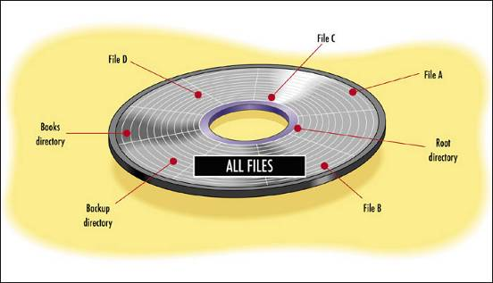
Physical File Storage
Files stored in random access on disk
FAT or MFT helps OS locate the needed clusters as needed

Slide 4
File Storage Hierarchy
Drives
  Root Directory
    Other Directories (Folders)
      Files
Folders can contain other folders

Slide 5
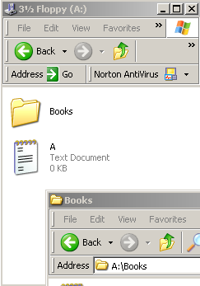
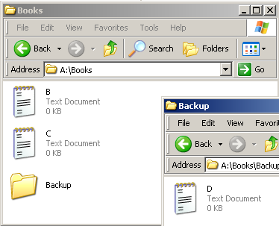
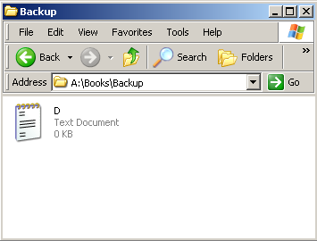
File Storage Hierarchy

Slide 6
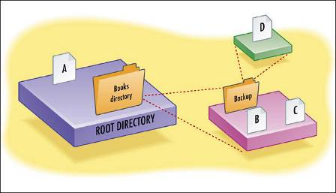
Root Directory
Top-level organizational unit on a logical disk
Physically, a small database file
Contains pointers to any files and folders stored within it

Slide 7
Floppy Disks
5.25” (obsolete)
  Double sided, double density, 360KB
  Double sided, high density, 1.2MB
3.5”
  Double-sided, double density, 720KB
  Double-sided, high density, 1.44MB

Slide 8
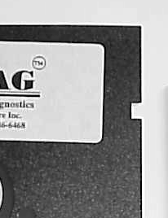
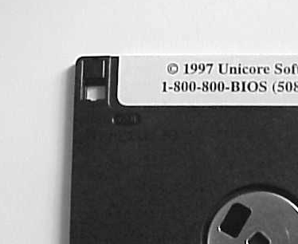
Write-Protecting a Floppy Disk
5.25” Disk
3.5” Disk
Place tape over notch
Slide tab to open position

Slide 9
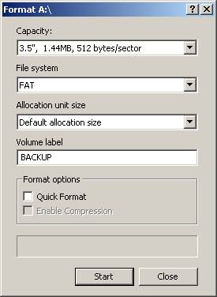
Formatting a Floppy Disk
Command prompt: FORMAT A:
  /S transfers system files
  /Q does a quick format
Windows: Right-click drive and choose Format

Slide 10
Floppy Disk Care
Avoid magnets
Avoid extremes of heat and cold
Do not get the disk wet
Do not expose the disk surface
Keep 5.25” disks in dust jackets

Slide 11
Partitioning Hard Disks: MS-DOS and Windows 9x
Command prompt utility FDISK
Required before a disk can be used
Required before OS can be installed

Slide 12
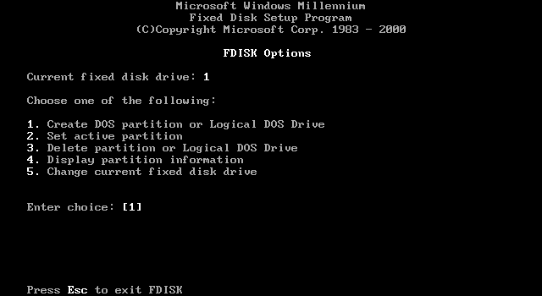
FDISK

Slide 13
Formatting Hard Disks: MS-DOS and Windows 9x
Command prompt utility FORMAT
  Required before OS can be installed
Windows Format Utility
  An alternative to FORMAT, provided Windows is already installed and this is an additional drive being added

Slide 14
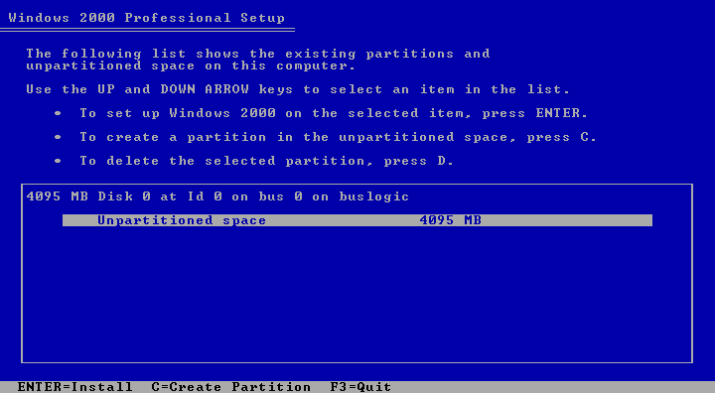
Partitioning in Windows 2000 or XP Setup
Windows 2000 and XP Setup has built-in partitioning and formatting utility

Slide 15
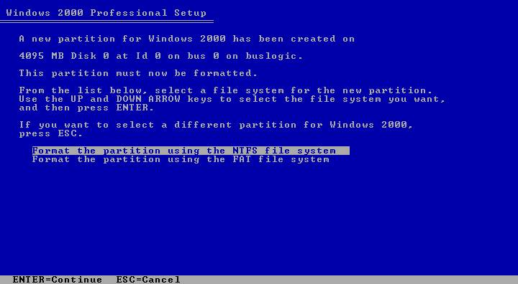
Formatting in Windows 2000 or XP Setup

Slide 16
Disk Management in Windows 2000/XP
Takes the place of FDISK and FORMAT commands
From Control Panel, choose Administrative Tools, then Computer Management, then Disk Management

Slide 17
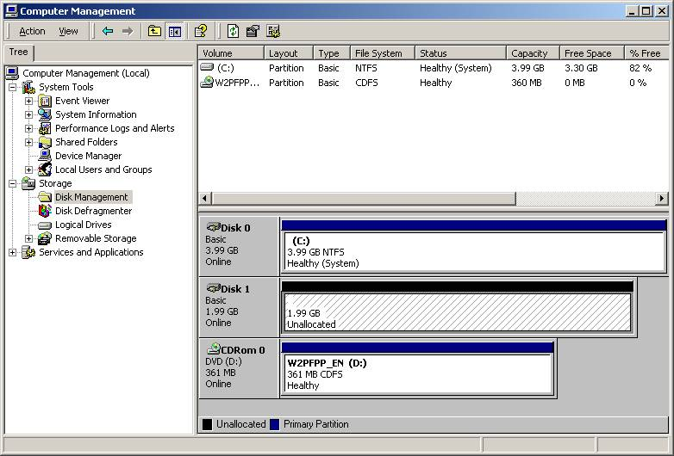
Disk Management in Windows 2000/XP

Slide 18
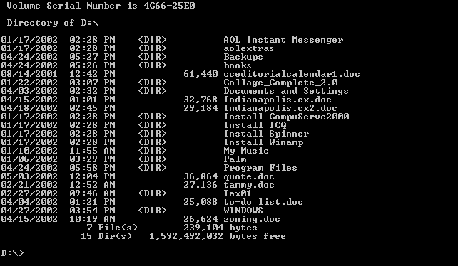
DIR
/W for multi-column display
/P for one page at a time

Slide 19
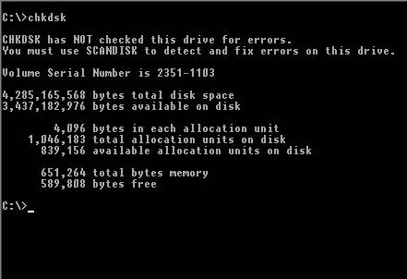
CHKDSK
Checks for FAT errors, precursor to Scandisk in Windows 9x
Does not correct them unless /F switch is used

Slide 20
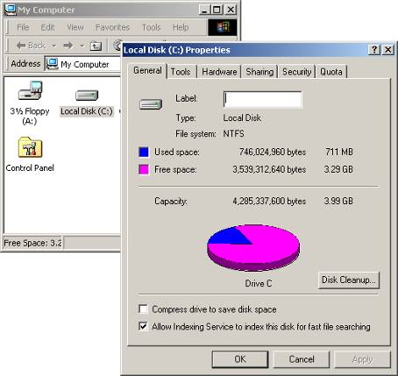
My Computer
Right-click drive and choose Properties

Slide 21
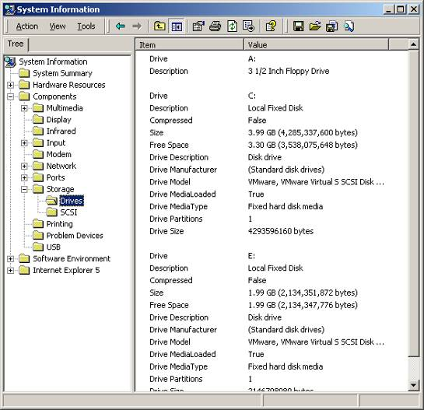
System Information
Look in Storage category

Slide 22
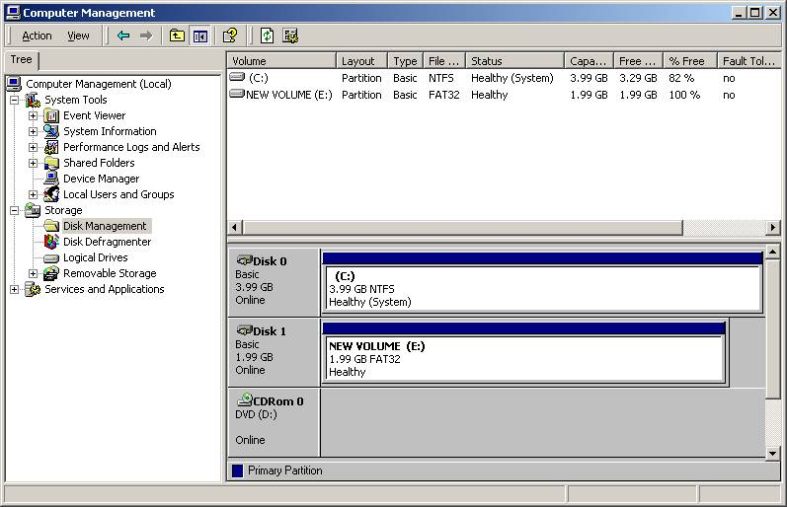
Disk Management

Slide 23
Troubleshooting Hard Disks
BIOS sees drive but OS does not
  Not partitioned yet
Windows sees drive but cannot read it
  Not formatted yet
Not bootable
  Boot files missing
Data errors reading or writing
  Damaged area on disk, run disk check

Slide 24
Troubleshooting Hard Disks
Sector not found error
  Could be physical problem
  Could be a problem with BIOS setup, FAT or MFT, or virus
  Back up data as possible, repartition, reformat
Loss of partition information
  Physical problem or virus
  Disk recovery tools available (3rd party)

